Slide 1

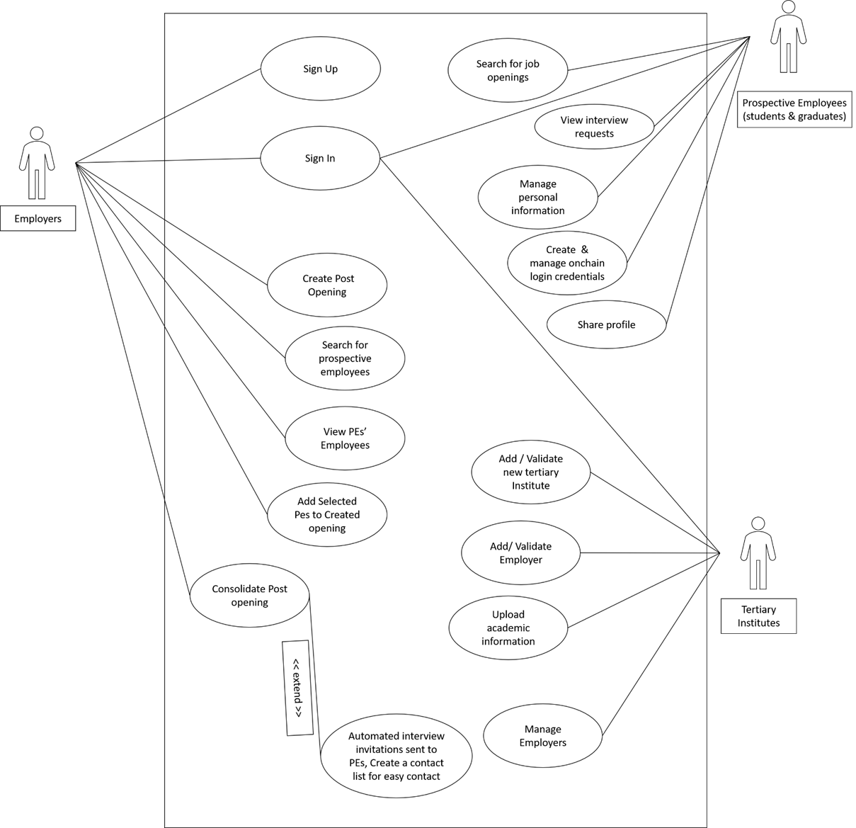
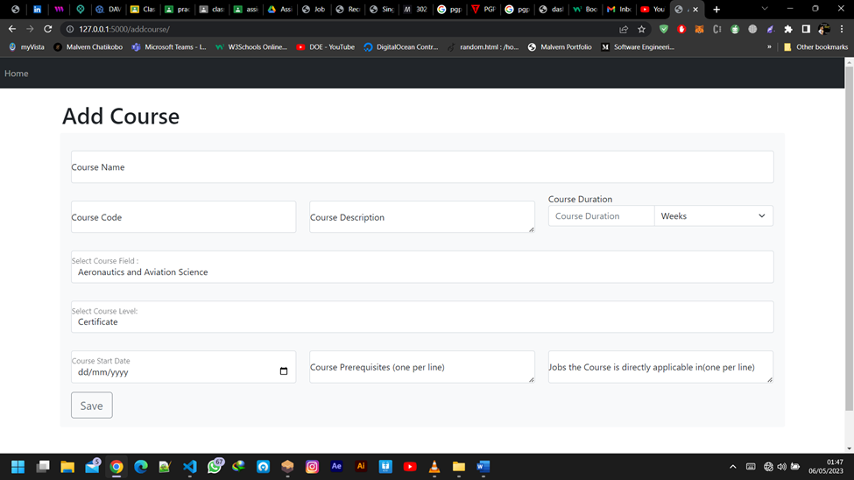
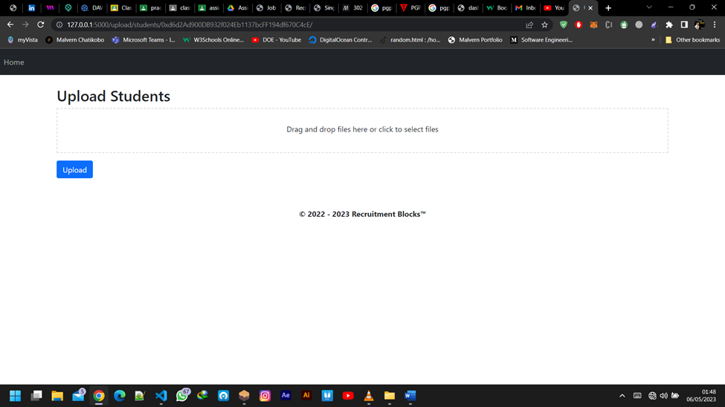
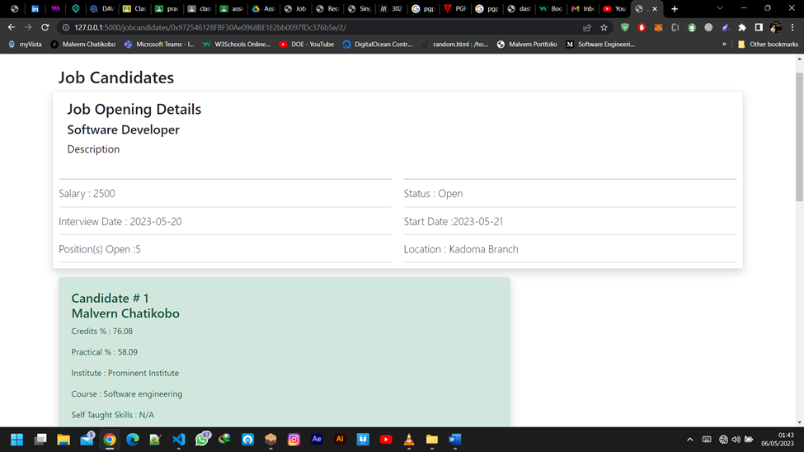
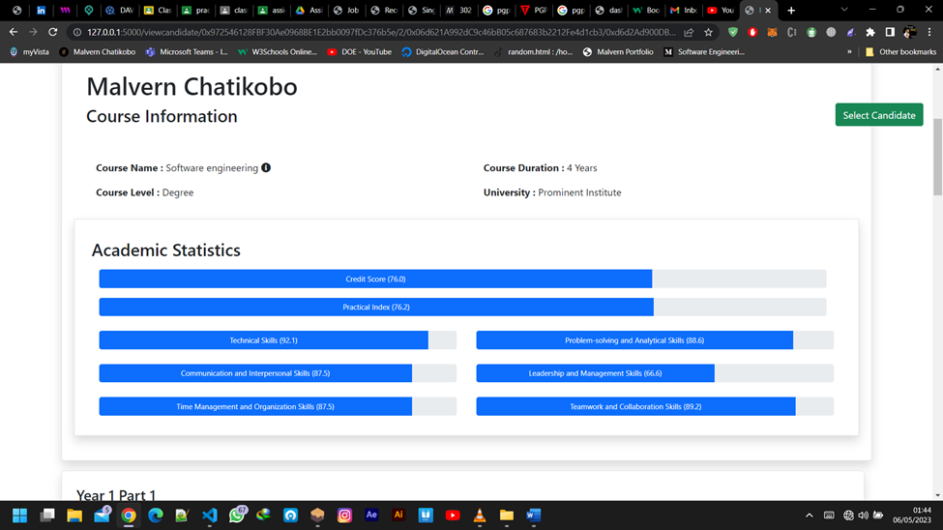
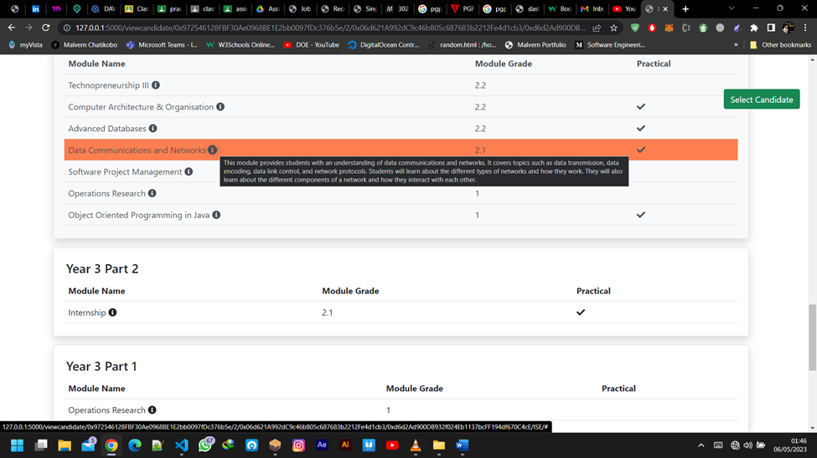
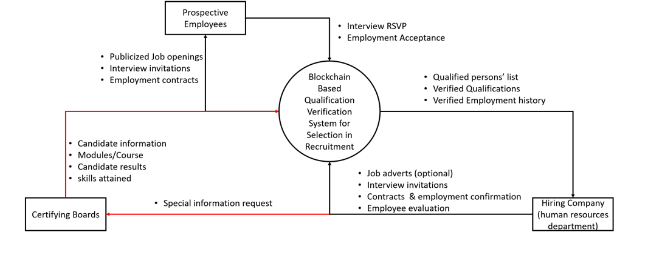
Recruitment BloQs: A Blockchain Academic
Record Based Recruitment System
Malvern Chatikobo - Software Engineering Department
1.0 Abstract
3.0. Problem definition
7.0. Use Case Diagram
The recruitment process for tertiary education
students and graduates is plagued by academic fraud and
inequality. To address these issues, we propose a blockchain based platform that allows universities and tertiary institutions
to post information about individuals' education, and companies
to post job openings. The system matches candidates with the
appropriate education for the job, ranks them based on academic
excellence, and presents them to the employer. The platform is
built on blockchain technology, making it reliable and secure. It
also provides a fair and equal opportunity for students and
graduates to showcase their skills and qualifications while
reducing academic fraud. The developed system offers a reliable,
secure, and fair way to recruit tertiary education students and
graduates, making the recruitment process more effective and
accessible for companies.
Keywords: blockchain, recruitment, academic fraud, smart
contracts, tertiary education.
The recruitment process in Zimbabwe is riddled with favoritism and non-systematic practices. This, to some extent, contributes to unemployment and consequently brain drain. With the recruitment current process, if a job gets high volumes of applicants, it will take a long time to create a short list of candidates who qualify who will be invite for interview.
Problems currently faced during the recruitment process include:
Faked academic qualifications
Companies poor advertising of job openings
Time consumed in analyzing resumes and verifying academic records and job histories2
most applicants that apply for jobs they are not directly qualified for among others.
Lack of a pool of experts to choose from
Startups do not get as many applicants to be sure they have the exact qualities the need
4.0. Overview of the developed application
8.0. Screenshots
2.0. Introduction
The developed blockchain-based platform addresses weaknesses in the recruitment process for tertiary education students and graduates. It aims to simplify and improve recruitment by providing companies with a pool of qualified professionals based on their academic records. The platform stores academic results on the blockchain, ensuring verifiability and reducing academic fraud. Companies register with participating tertiary institutes to access potential candidates and initially see academic results and skills. Students have control over the information visible to recruiters through smart contracts. Overall, the platform offers a secure and reliable way to store and verify academic records, streamlines recruitment for companies, and provides a fair opportunity for students and graduates to showcase their qualifications.
The paper proposes a blockchain-based platform to address the shortcomings of the current recruitment process for tertiary education students and graduates. It aims to eliminate issues like academic fraud, unequal opportunities, and discrimination.
The platform allows universities and tertiary institutions to share education information, while companies can post job openings. Using blockchain technology, the system matches candidates with suitable qualifications to job requirements, ranks them based on academic excellence, and presents them to employers.
The platform also facilitates interview invitations through provided links. Storing all information on the blockchain ensures verification and validity.
The paper discusses the features and benefits of the developed system for students, graduates, and companies. Previous studies have explored blockchain's potential in education verification and skill tracking, highlighting its ability to eliminate fraud, ensure authenticity, and promote equality in recruitment.
providing a secure and reliable method to store and verify academic records, the developed platform aims to enhance the recruitment process, reduce academic fraud, and offer fair opportunities for students and graduates to showcase their qualifications.
Conclusion
In conclusion, the developed blockchain-based platform for the recruitment process of tertiary education students and graduates offers a reliable, secure, and fair way for students and graduates to showcase their skills and qualifications to companies. The platform provides a secure way to store and verify academic records, reducing the amount of academic fraud, and bringing equality to the recruitment process. The developed system will provide a fair and equal opportunity for students and graduates to showcase their skills and qualifications and make the recruitment process easier and more effective for companies.
5.0. Objectives
To develop a blockchain system to store relevant tertiary institute academic records and employment history records.
To develop a system which can be used to verify any information pertaining skills and employment history of an individual.
To develop a web platform for companies to find employment eligible university students (current or past)
To develop a system that can map a student’s proficient areas to an area of specialization for easier display to influence the decision making.
Supervisor – L Amos
6.0. System Overview

